Slide 1

STATIC STRETCHING + MAJOR MUSCLE GROUPS
PHYSICAL EDUCATION

Slide 2

LESSON OBJECTIVES:
THE IMPORTANCE OF STATIC STRETCHING IN RELATION TO THE BODY AND PHYSICAL ACTIVITY.
THE MAJOR MUSCLES GROUPS AND THEIR RESPECTIVE LOCATIONS.
HOW THE MAJOR MUSCLES GROUPS AND STATIC STRETCHING ARE INTERRELATED.
IDENTIFY THE PHYSICAL COMPONENT THAT STATIC STRETCHING IS RELATED TO.

Slide 3
WHAT MAJOR COMPONENT DOES STATIC STRETCHING FALL UNDER IN PYHSICAL EDUCATION?
FLEXIBILITY

Slide 4


FLEXIBILITY
The range of motion in joints and muscles.

Slide 5
WHAT IS THE IMPORTANCE OF FLEXIBILITY AND PROPER WARM-UP BEFORE PHYSICAL ACTIVITY?
FLEXIBILITY AND PROPER WARM-UP ARE ESSENTIAL COMPONENTS OF A SAFE AND EFFECTIVE PHYSICAL ACTIVITY ROUTINE. THEY PLAY CRUCIAL ROLES IN PREPARING THE BODY FOR EXERCISE, REDUCING THE RISK OF INJURY, AND ENHANCING OVERALL PERFORMANCE.

Slide 6
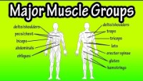

Slide 7
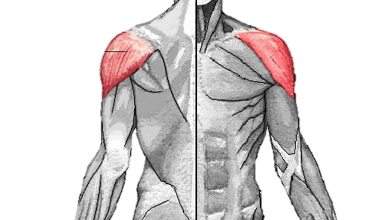
DELTOIDS

Slide 8
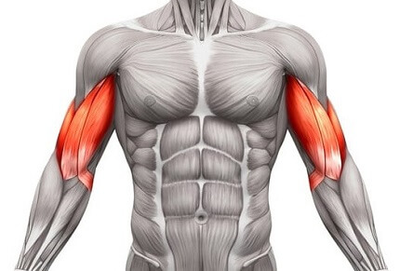
BICEPS

Slide 9
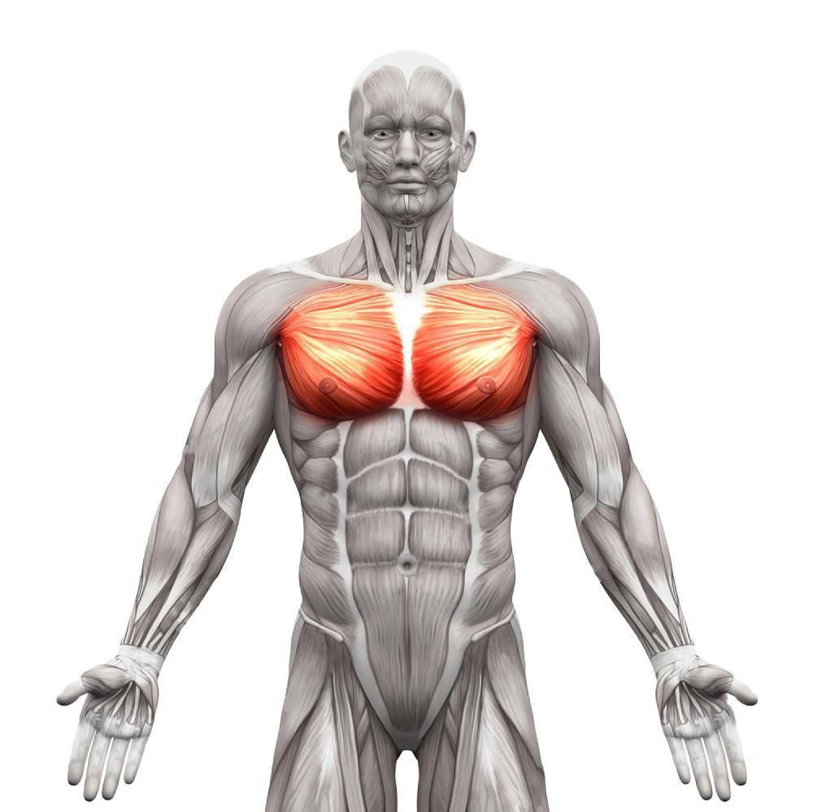
PECTORALIS

Slide 10
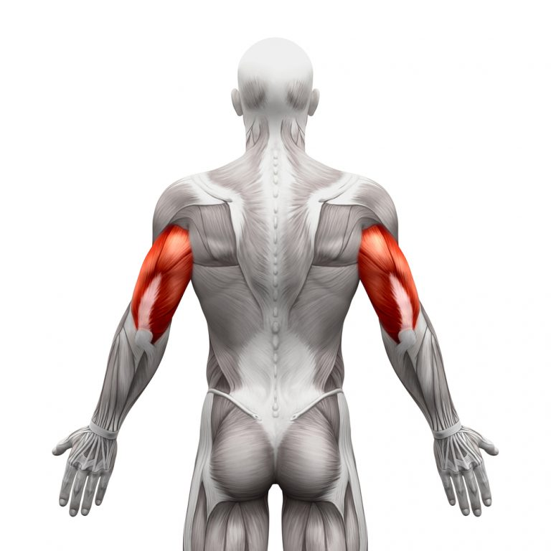
TRICEPS

Slide 11
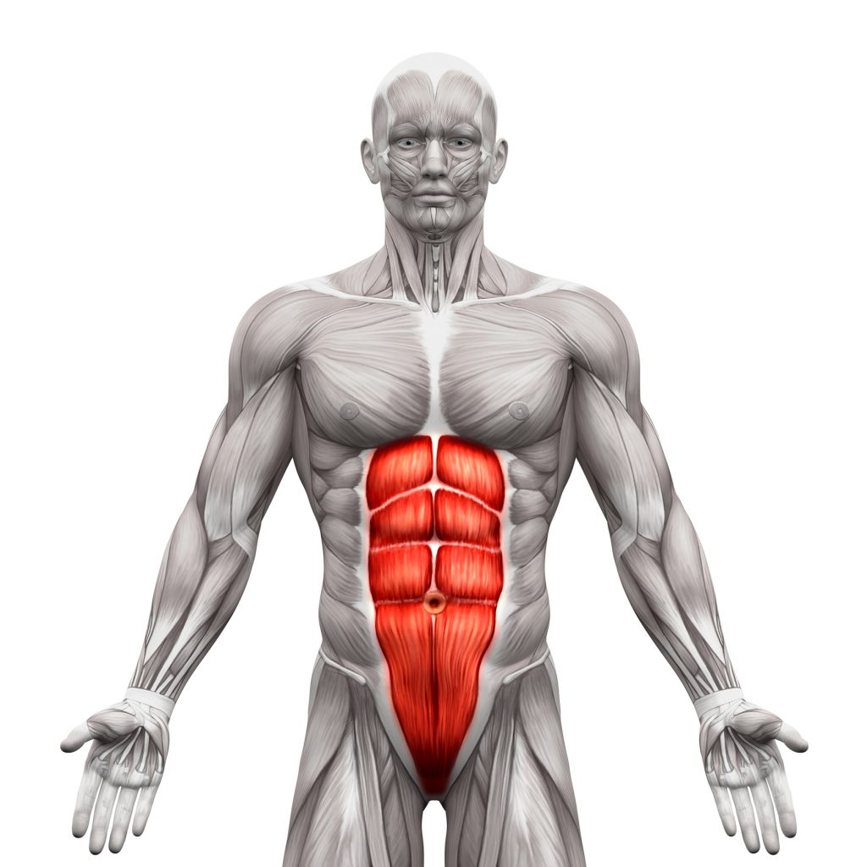
ABDOMINALS

Slide 12
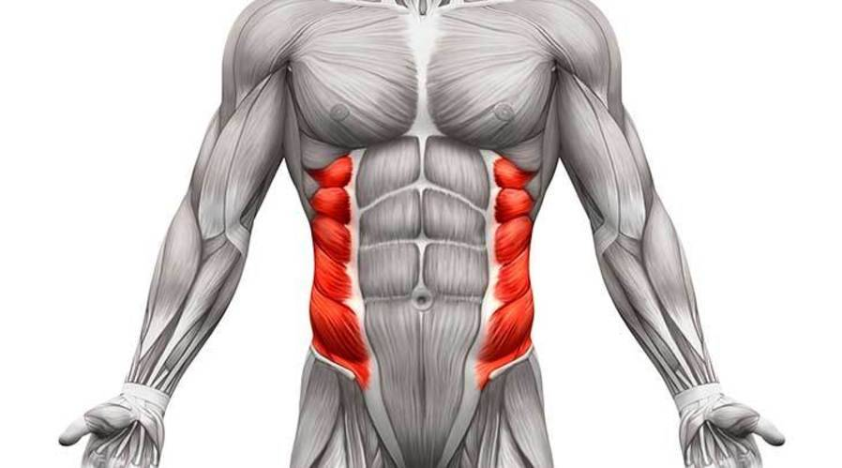
OBLIQUES

Slide 13
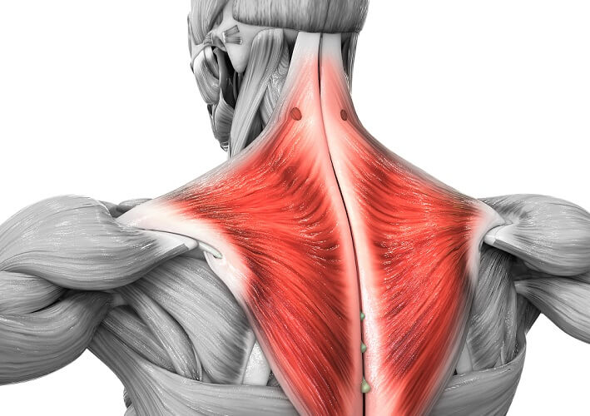
TRAPEZIUS/ TRAPS

Slide 14
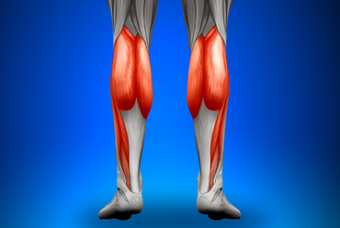
CALVES

Slide 15
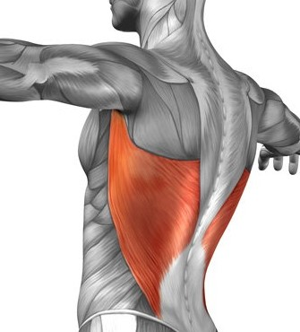
LATS

Slide 16
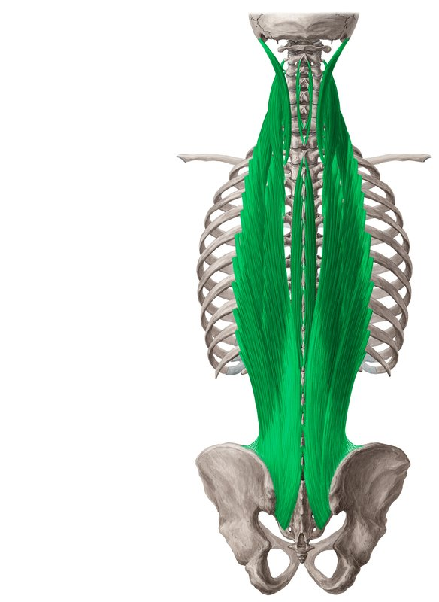
ERECTOR SPINAE

Slide 17
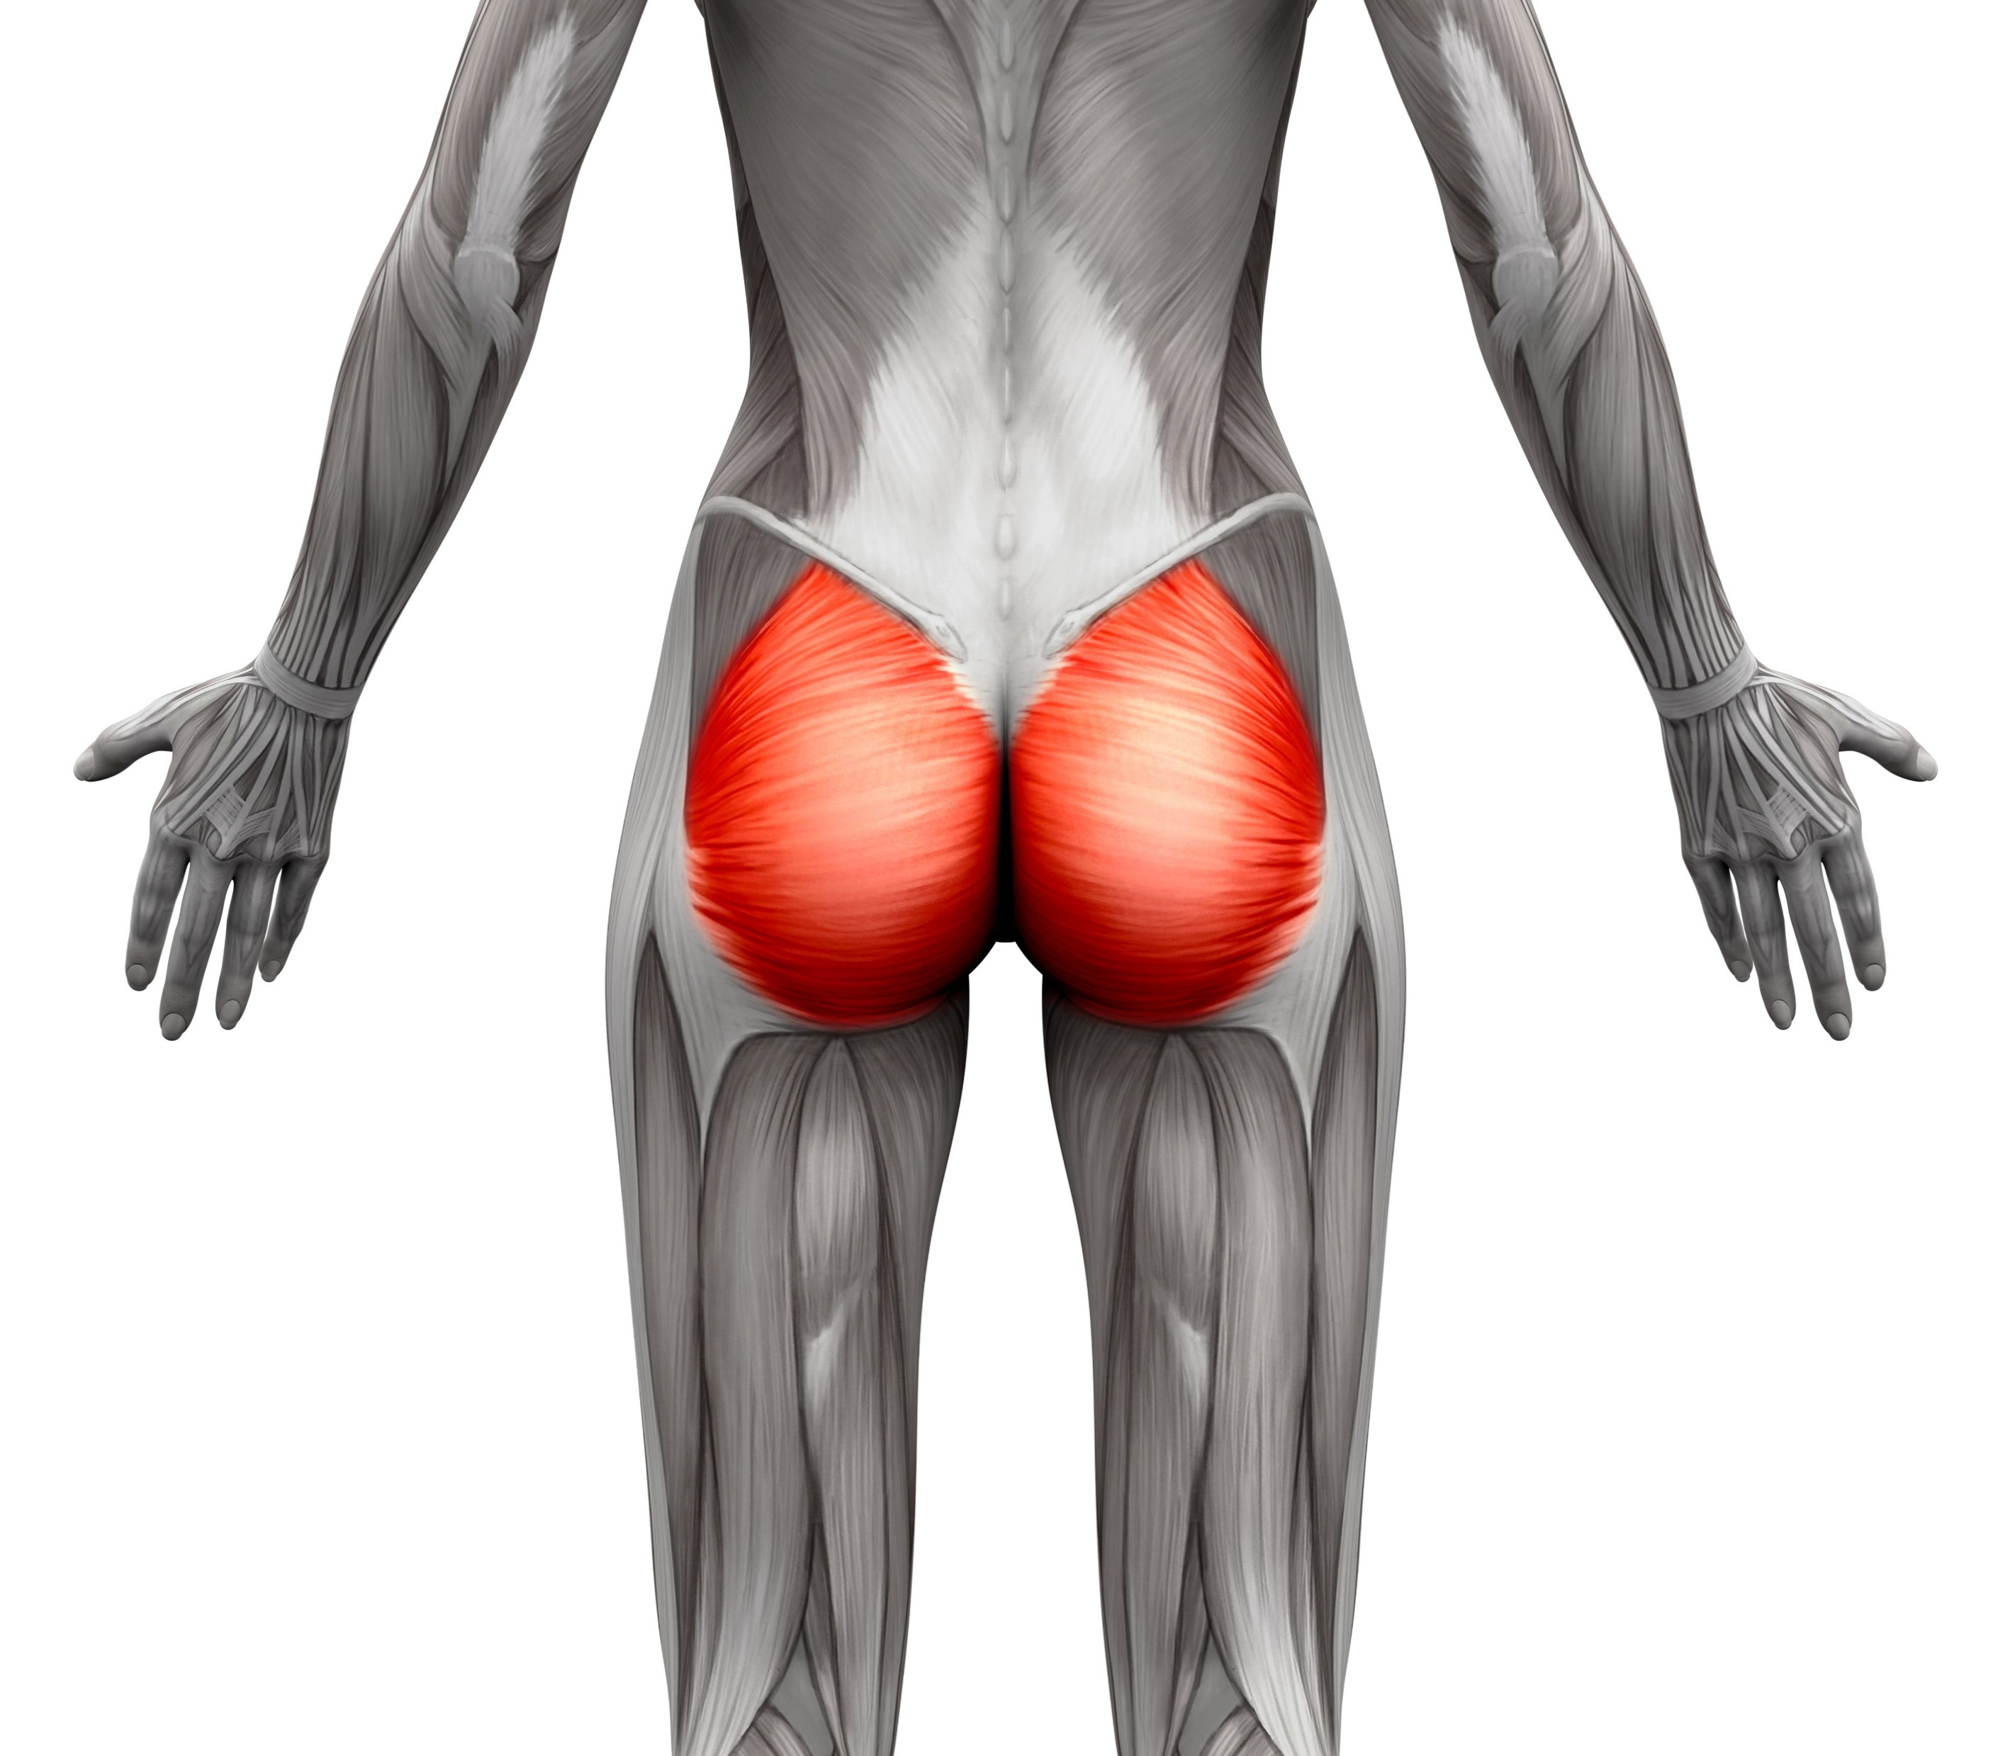
GLUTES

Slide 18
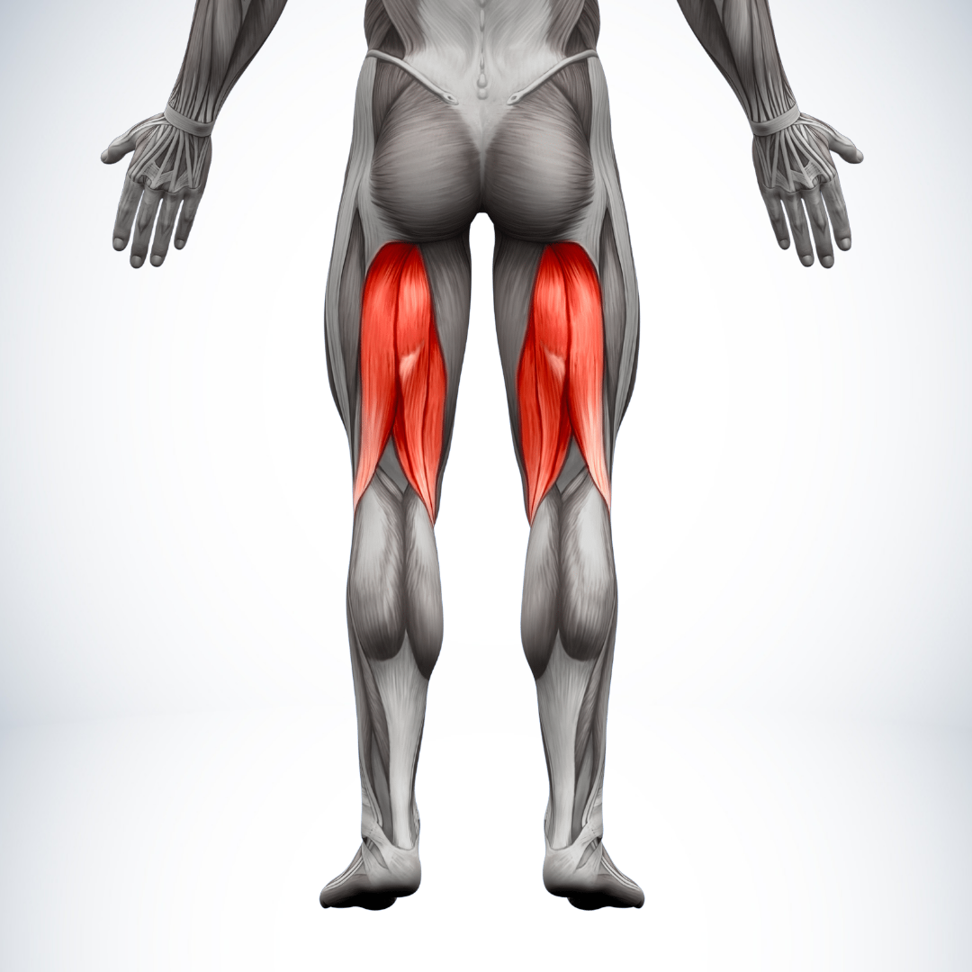
HAMSTRINGS

Slide 19
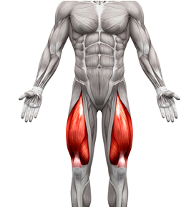
QUADRICEPS/ QUADS

Slide 20
WHY IS FLEXIBILITY IMPORTANT?
A. IMPROVED RANGE OF MOTION: FLEXIBILITY REFERS TO THE ABILITY OF JOINTS AND MUSCLES TO MOVE THROUGH THEIR FULL RANGE OF MOTION. HAVING GOOD FLEXIBILITY ALLOWS FOR SMOOTHER AND MORE EFFICIENT MOVEMENT PATTERNS, REDUCING THE RISK OF STRAINED OR RESTRICTED MOVEMENTS DURING EXERCISE.
B. INJURY PREVENTION: FLEXIBLE MUSCLES AND CONNECTIVE TISSUES ARE LESS PRONE TO STRAINS, TEARS, AND OTHER INJURIES. ADEQUATE FLEXIBILITY HELPS ABSORB THE IMPACT AND STRESS PLACED ON MUSCLES AND JOINTS DURING PHYSICAL ACTIVITY, REDUCING THE RISK OF OVERUSE INJURIES.
C. ENHANCED POSTURE: GOOD FLEXIBILITY CONTRIBUTES TO BETTER POSTURE BY ALLOWING MUSCLES TO MAINTAIN THEIR PROPER LENGTH-TENSION RELATIONSHIPS. IMPROVED POSTURE REDUCES THE STRAIN ON CERTAIN MUSCLE GROUPS AND MINIMIZES THE RISK OF DEVELOPING MUSCULOSKELETAL IMBALANCES.
D. MUSCLE RELAXATION: STRETCHING PROMOTES RELAXATION AND TENSION RELEASE IN MUSCLES. THIS CAN ALLEVIATE MUSCLE STIFFNESS AND DISCOMFORT, CONTRIBUTING TO OVERALL COMFORT DURING AND AFTER EXERCISE.
Notes:
Have students answer slide title question before revealing the answers.

Slide 21
WHY IS A PROPER WARM-UP IMPORTANT?
A. INCREASED BLOOD FLOW: WARMING UP GRADUALLY INCREASES HEART RATE, BLOOD FLOW, AND CIRCULATION. THIS HELPS DELIVER OXYGEN AND NUTRIENTS TO MUSCLES, PREPARING THEM FOR THE INCREASED DEMAND THAT EXERCISE PLACES ON THEM.
B. IMPROVED MUSCLE FUNCTION: A WARM-UP HELPS INCREASE MUSCLE TEMPERATURE, MAKING MUSCLES MORE PLIABLE AND RESPONSIVE. THIS ENHANCES MUSCLE CONTRACTILITY AND REDUCES THE RISK OF MUSCLE STRAINS.
C. ENHANCED NERVE FUNCTION: A WARM-UP ALSO IMPROVES NERVE FUNCTION AND RESPONSIVENESS. THIS IS IMPORTANT FOR THE COORDINATION AND TIMING OF MUSCLE CONTRACTIONS, LEADING TO BETTER MOTOR CONTROL AND PERFORMANCE.
D. MENTAL PREPARATION: WARMING UP MENTALLY PREPARES INDIVIDUALS FOR EXERCISE. IT HELPS SHIFT FOCUS FROM DAILY TASKS TO THE UPCOMING PHYSICAL ACTIVITY, ENHANCING CONCENTRATION AND READINESS TO PERFORM.
E. INJURY PREVENTION: A PROPER WARM-UP GRADUALLY PREPARES THE BODY FOR MORE INTENSE ACTIVITY, REDUCING THE RISK OF SUDDEN, JARRING MOVEMENTS THAT COULD LEAD TO INJURY. IT HELPS PREPARE JOINTS, LIGAMENTS, AND TENDONS FOR THE STRESS OF EXERCISE.
Notes:
Have students answer slide title question before revealing the answers.

Slide 22
WHAT ARE THE EFFECTS OF STATIC STRETCHING FOR THE MUSCLES:
INCREASED MUSCLE LENGTH: STATIC STRETCHING GENTLY PULLS AND LENGTHENS YOUR MUSCLES OVER TIME. IT'S LIKE STRETCHING A RUBBER BAND SO IT BECOMES LONGER AND MORE FLEXIBLE.
RELAXATION: THE STRETCHING HELPS MUSCLES RELAX, RELEASING ANY TENSION OR TIGHTNESS THAT MIGHT HAVE BUILT UP. IMAGINE A TIGHT KNOT IN A SHOELACE BEING LOOSENED.
BLOOD FLOW: STRETCHING PROMOTES BETTER BLOOD FLOW TO YOUR MUSCLES, WHICH BRINGS MORE OXYGEN AND NUTRIENTS. IT'S LIKE GIVING YOUR MUSCLES A LITTLE BOOST OF ENERGY.
Notes:
Have students answer slide title question before revealing the answers.

Slide 23
WHAT ARE THE BENEFITS OF STATIC STRETCHING:
Improved Flexibility
Enhanced Muscle Relaxation
Injury Prevention
Improved Posture
Increased Blood Circulation
Relaxation and Stress Relief
Better Joint Range of Motion
Long-Term Mobility
Mind-Body Connection
Better Performance
Active Lifestyle Support
Notes:
Have students read ALL the bullet points.

Slide 24
SAFETY AND GUIDELINES: (STATIC STRETCHING)
WARM UP BEFORE STATIC STRETCHING.
AVOID BOUNCING OR JERKING MOVEMENTS DURING STRETCHING.
BREATH DEEPLY AND CONSISTENTLY DURING STRETCHES.
LISTENING TO YOUR BODY AND AVOID EXCESSIVE DISCOMFORT OR PAIN.
STRETCHING SHOULD NOT BE PAINFUL.
Notes:
Teacher emphasizes the importance of this slide.

